Slide 1
Finding signals in financial markets
Kuba Dziarkowski

Slide 2
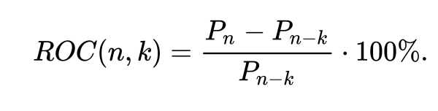
Momentum
What I was looking for
k for sale momentum
k for buy momentum
Border point (ROC)

Slide 3
Financial Instruments
Forrex – USD/EUR
Bonds – 20y US treasury bonds
Stocks – PKO BP
Indices – Nasdaq 100
Commodities – Crude Oil

Slide 4
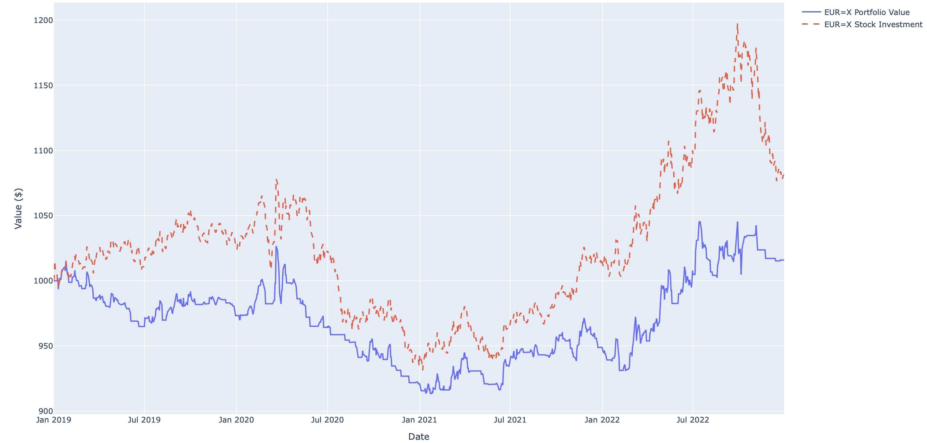
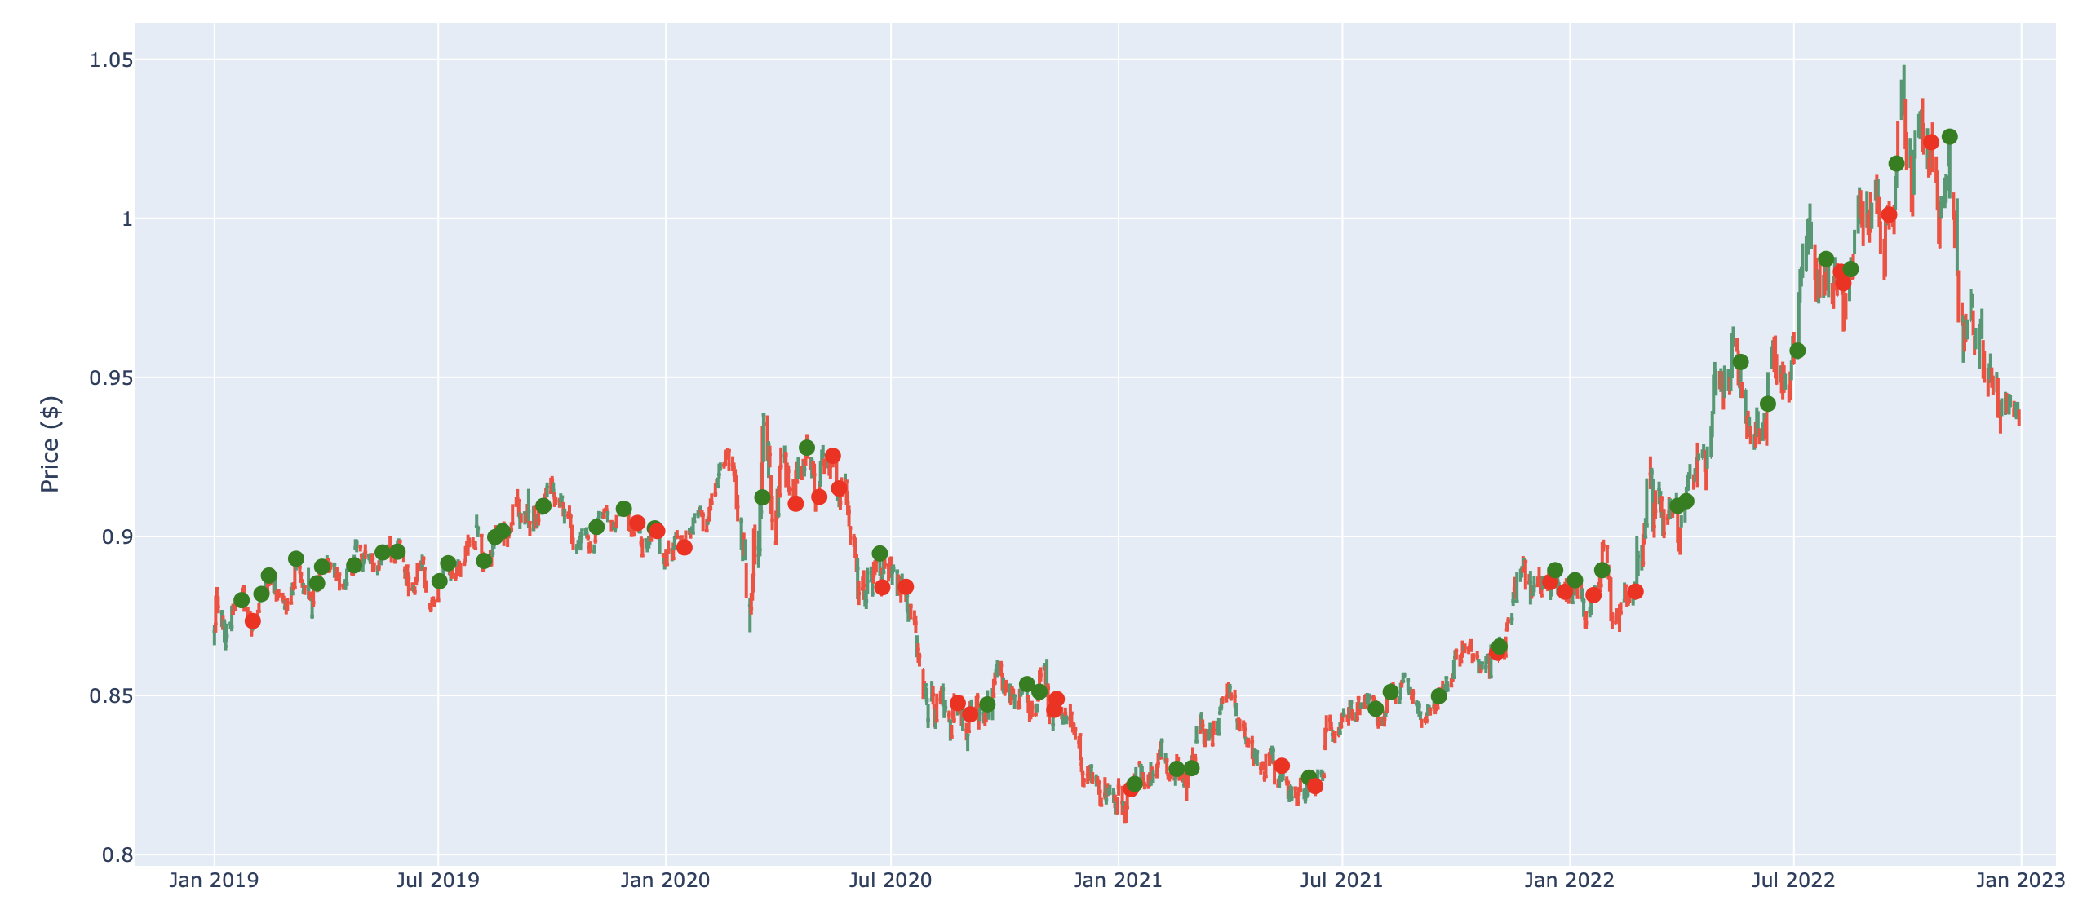
USD/EUR

Slide 5
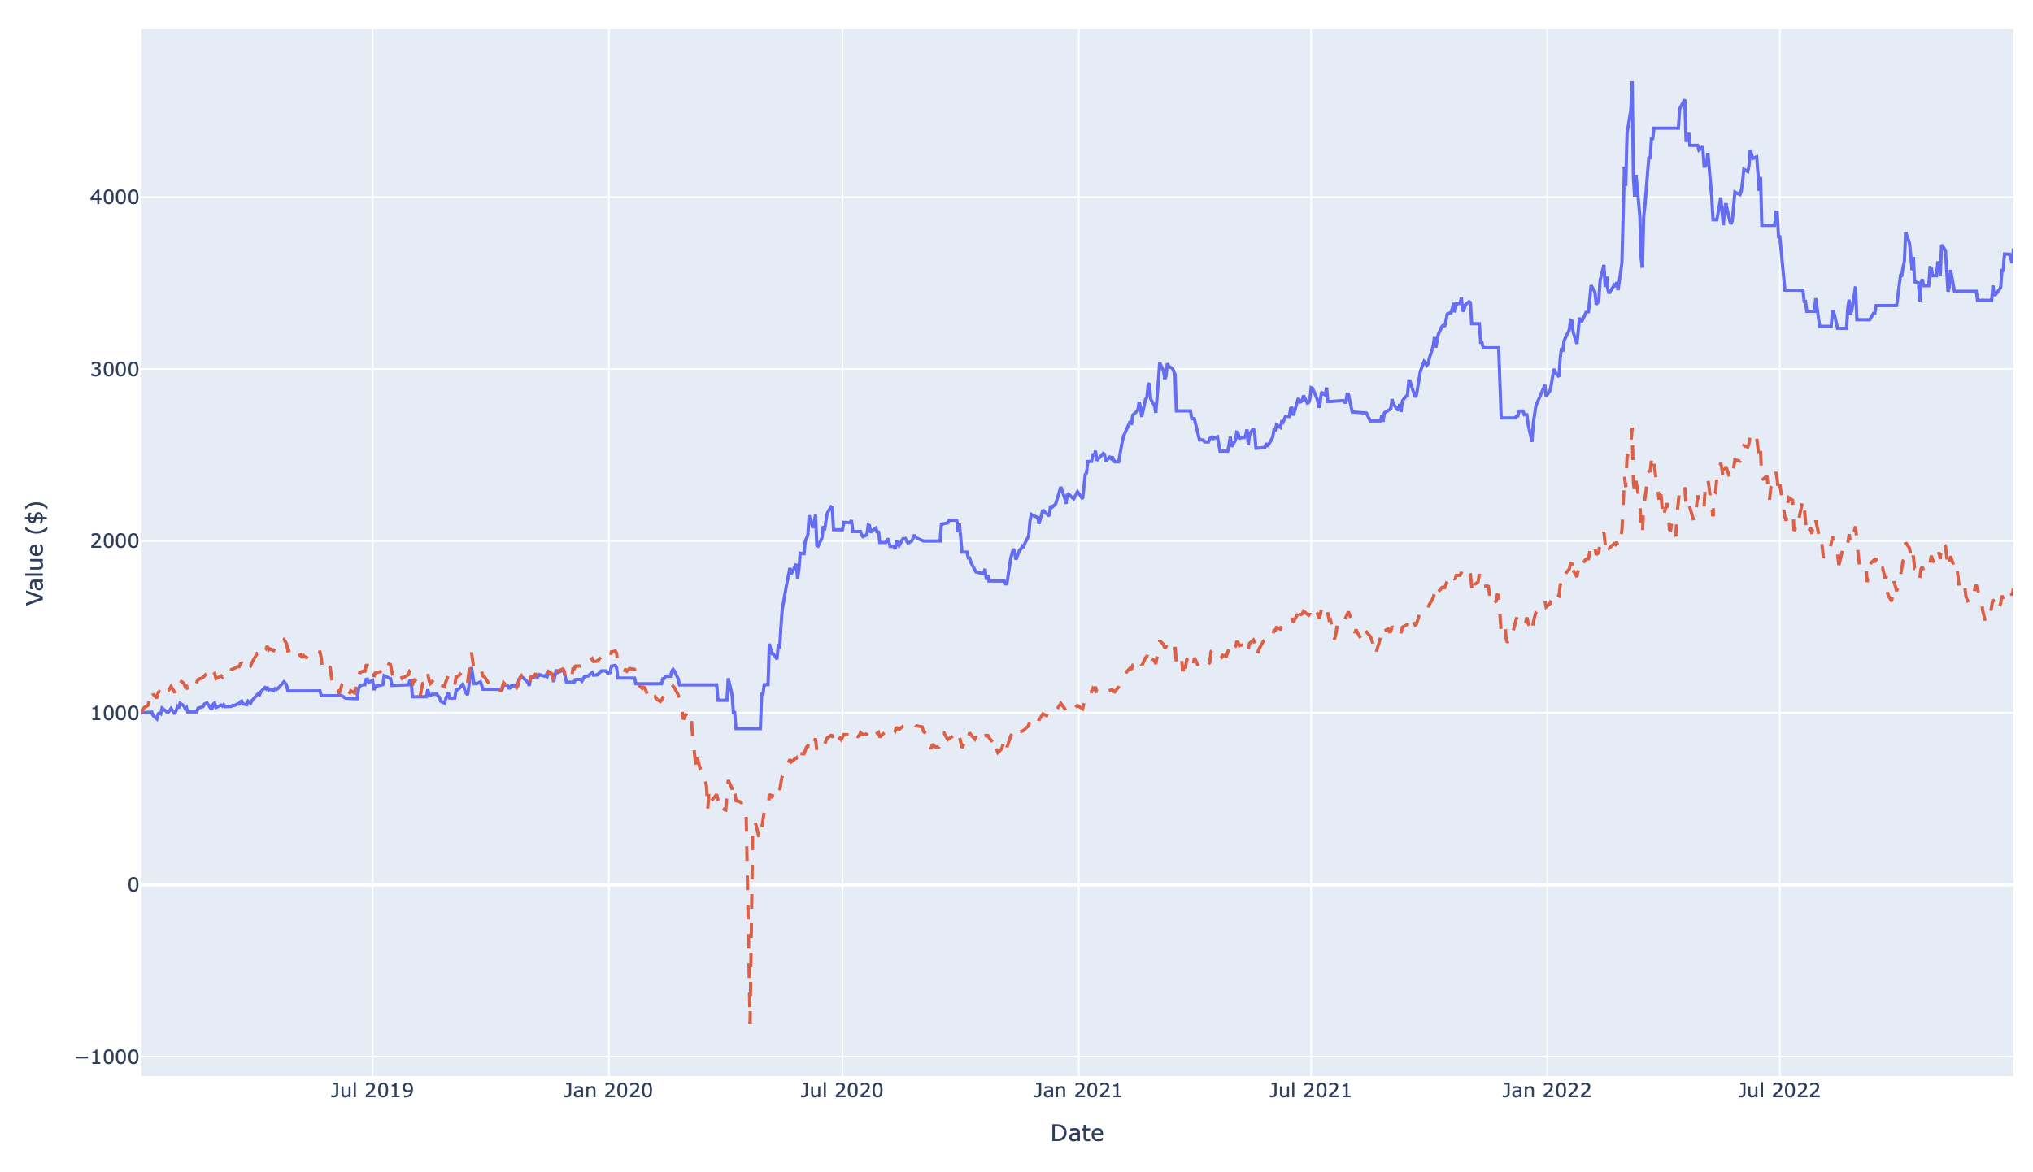
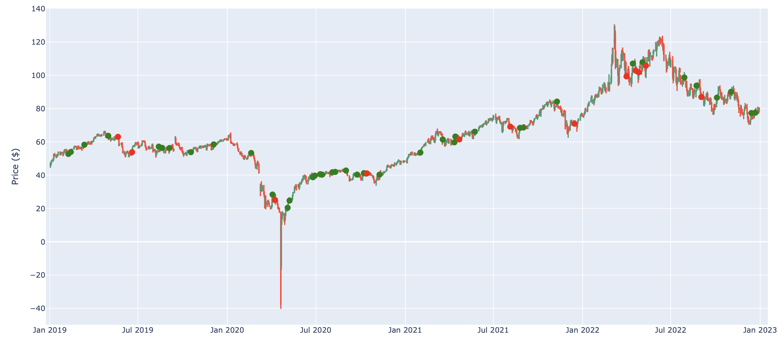
Crude Oil

Slide 6
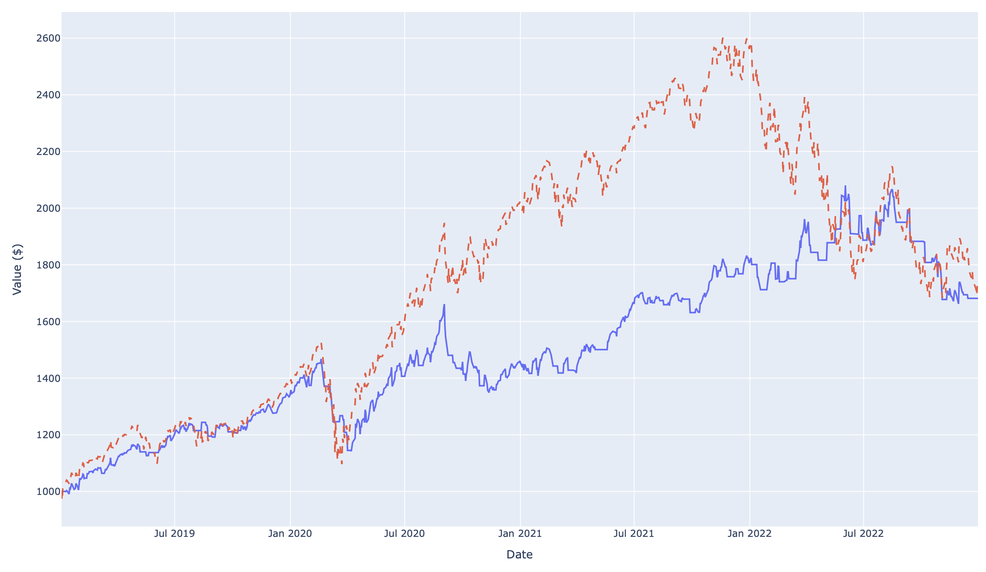
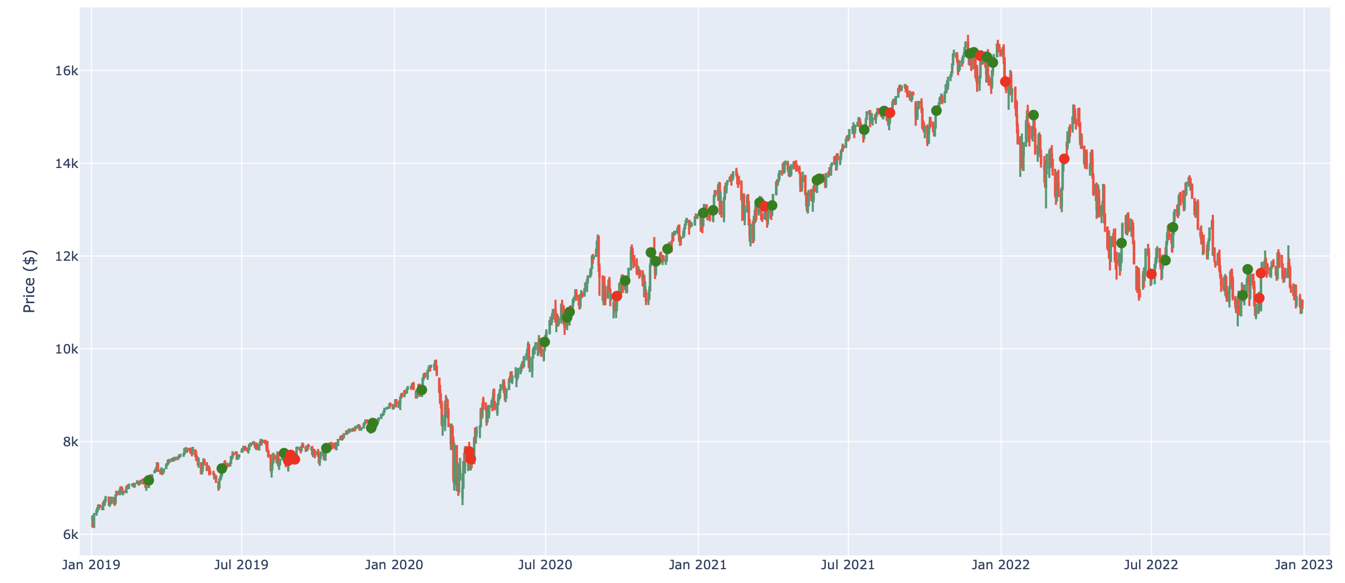
Nasdaq

Slide 7
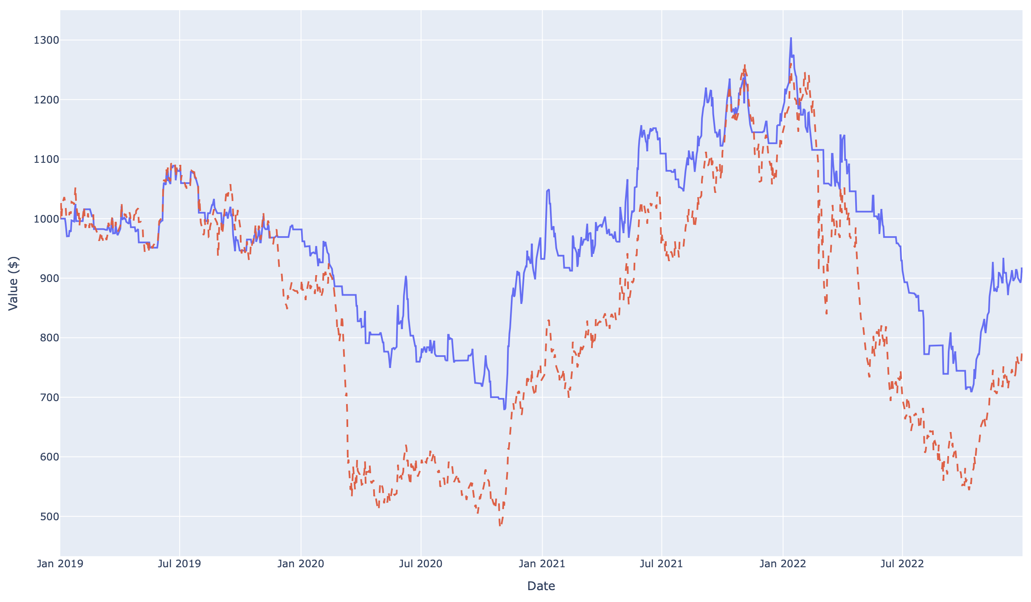
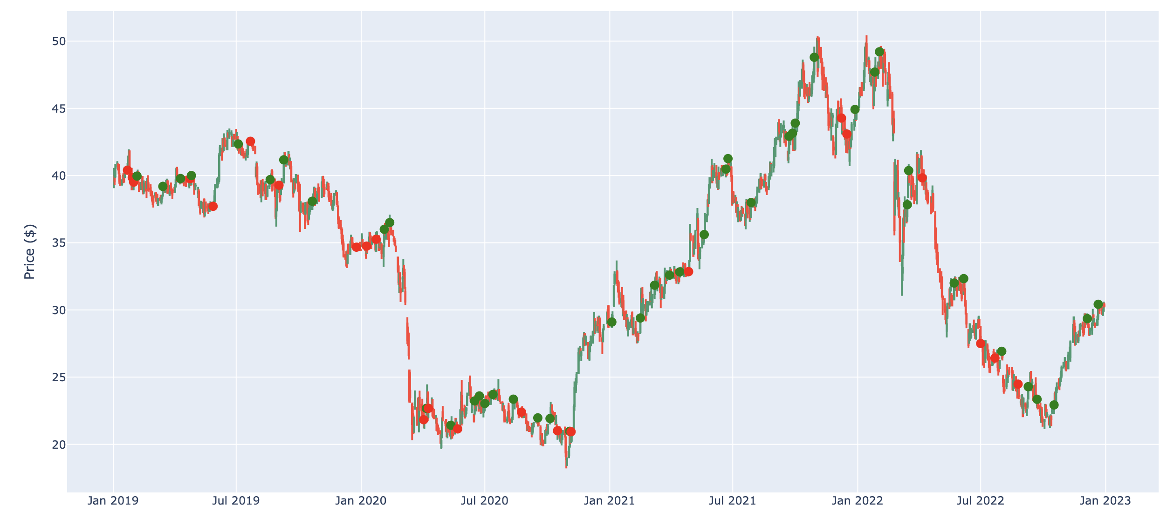
PKO BP

Slide 8
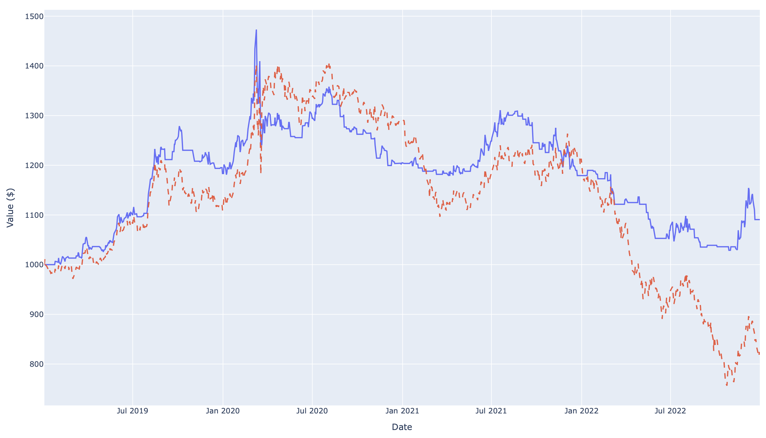
US 20y treasure bonds

Slide 9
Evaluation
 | USD/EUR | Crude Oil | Nasdaq | PKO BP | US 20y trasure bonds
Win Rate | 72% | 76% | 70% | 69% | 69%
Return of investment | 1.6% | 271% | 68% | -8% | 10%
Return of trading portfolio over underlying asset | -7.1% | 199% | -5% | 16% | 27%

